Slide 1

SUGNL 's-Hertogenbosch - Welcome
Sitecore 9 xConnect and Marketing Automation
Speakers:
Daniil Raschupkin - Lead Sitecore/.NET Developer at Brimit, Sitecore MVP 2017, Sitecore 9 Certified, MCP
Alexei Vershalovich - Managing Director at Brimit, Sitecore Team Lead & Consultant, Sitecore 9 Certified
Daniil @danlrby Alexei @lebeg

Slide 2
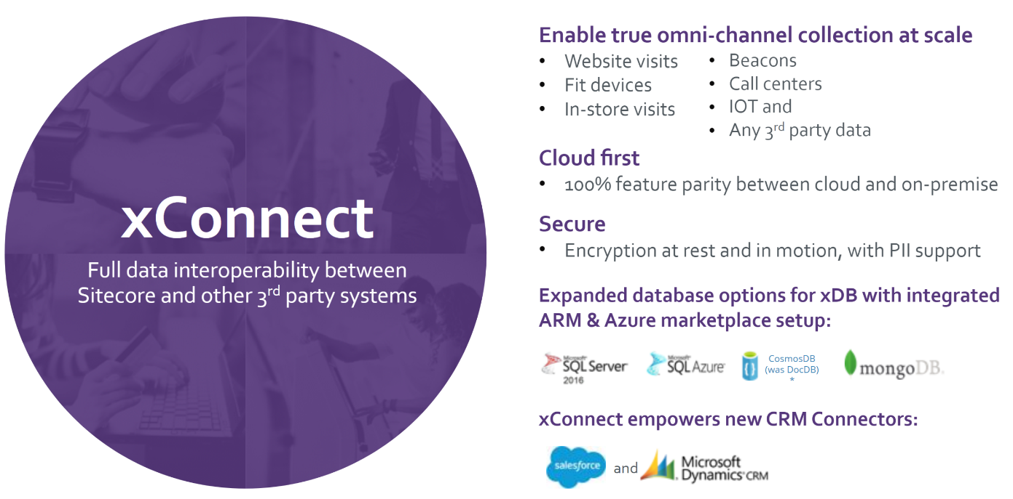
SUGNL – Sitecore xConnect
Sitecore 9 Partners Intro webinar
Daniil @danlrby Alexei @lebeg

Slide 3
SUGNL – Sitecore xConnect
Background (Sitecore 8.x Problems)
Scalability
Session expiration
Contact Locks
Extend model
Lack of documentation
Daniil @danlrby Alexei @lebeg

Slide 4
SUGNL – Sitecore xConnect
Background (Sitecore 8.x Problems)
Scalability
Session expiration
Contact Locks
Extend model
Lack of documentation
Scalable &
Cloud ready (PaaS)
Developer friendly & well documented
Secure, supports GDPR EU regulation
Omni-channel ready & customizable
https://doc.sitecore.net/developers/
Daniil @danlrby Alexei @lebeg

Slide 5
SUGNL – Sitecore xConnect
Edit xDB Contact (SC 8.x)
Edit Contact with xConnect
public void SetContactData(string username)
{
LeaseOwner leaseOwner = new LeaseOwner("YOUR_WORKER_NAME", LeaseOwnerType.OutOfRequestWorker);
ContactRepositoryBase contactRepository = Factory.CreateObject("contactRepository", true) as ContactRepositoryBase;
// Attempt to obtain an exclusive lock on an existing contact in xDB.
LockAttemptResult<Contact> lockResult = contactRepository.TryLoadContact(username, leaseOwner, TimeSpan.FromMinutes(1));
Contact contact = null;
if (lockResult.Status == LockAttemptStatus.AlreadyLocked)
{
// Another worker or a live web session has an exclusive lock on the contact.
// You can't use this contact right now. It's up to you what to do in this case.
/* ... */
}
else if (lockResult.Status == LockAttemptStatus.DatabaseUnavailable)
{
// Database is down. Try to handle this gracefully.
/* ... */
}
else if (lockResult.Status == LockAttemptStatus.NotFound)
{
// A contact with the given identifier doesn't exist.
// Just create a new contact object.
contact = contactRepository.CreateContact(Guid.NewGuid());
// Identify it.
contact.Identifiers.Identifier = username;
// And make it known.
contact.Identifiers.IdentificationLevel = Sitecore.Analytics.Model.ContactIdentificationLevel.Known;
}
else
{
// We successfull locked an existing contact.
contact = lockResult.Object;
}
// Set some contact facets:
/* ... */
// Save the contact and release the lock.
if (contact != null)
{
var options = new ContactSaveOptions(release: true, owner: leaseOwner);
contactRepository.SaveContact(contact, options);
}
}
public void UpdateContact(string source, string identifier, Data data)
{
using (XConnectClient client = GetClient())
{
IdentifiedContactReference reference = new IdentifiedContactReference(source, identifier);
Contact contact = client.Get<Contact>(reference, new ContactExpandOptions(PersonalInformation.DefaultFacetKey));
if (contact == null)
{
return;
}
// Set Facets
client.SetFacet<PersonalInformation>(contact, PersonalInformation.DefaultFacetKey, personalInformation);
client.Submit();
}
}
Daniil @danlrby Alexei @lebeg

Slide 6
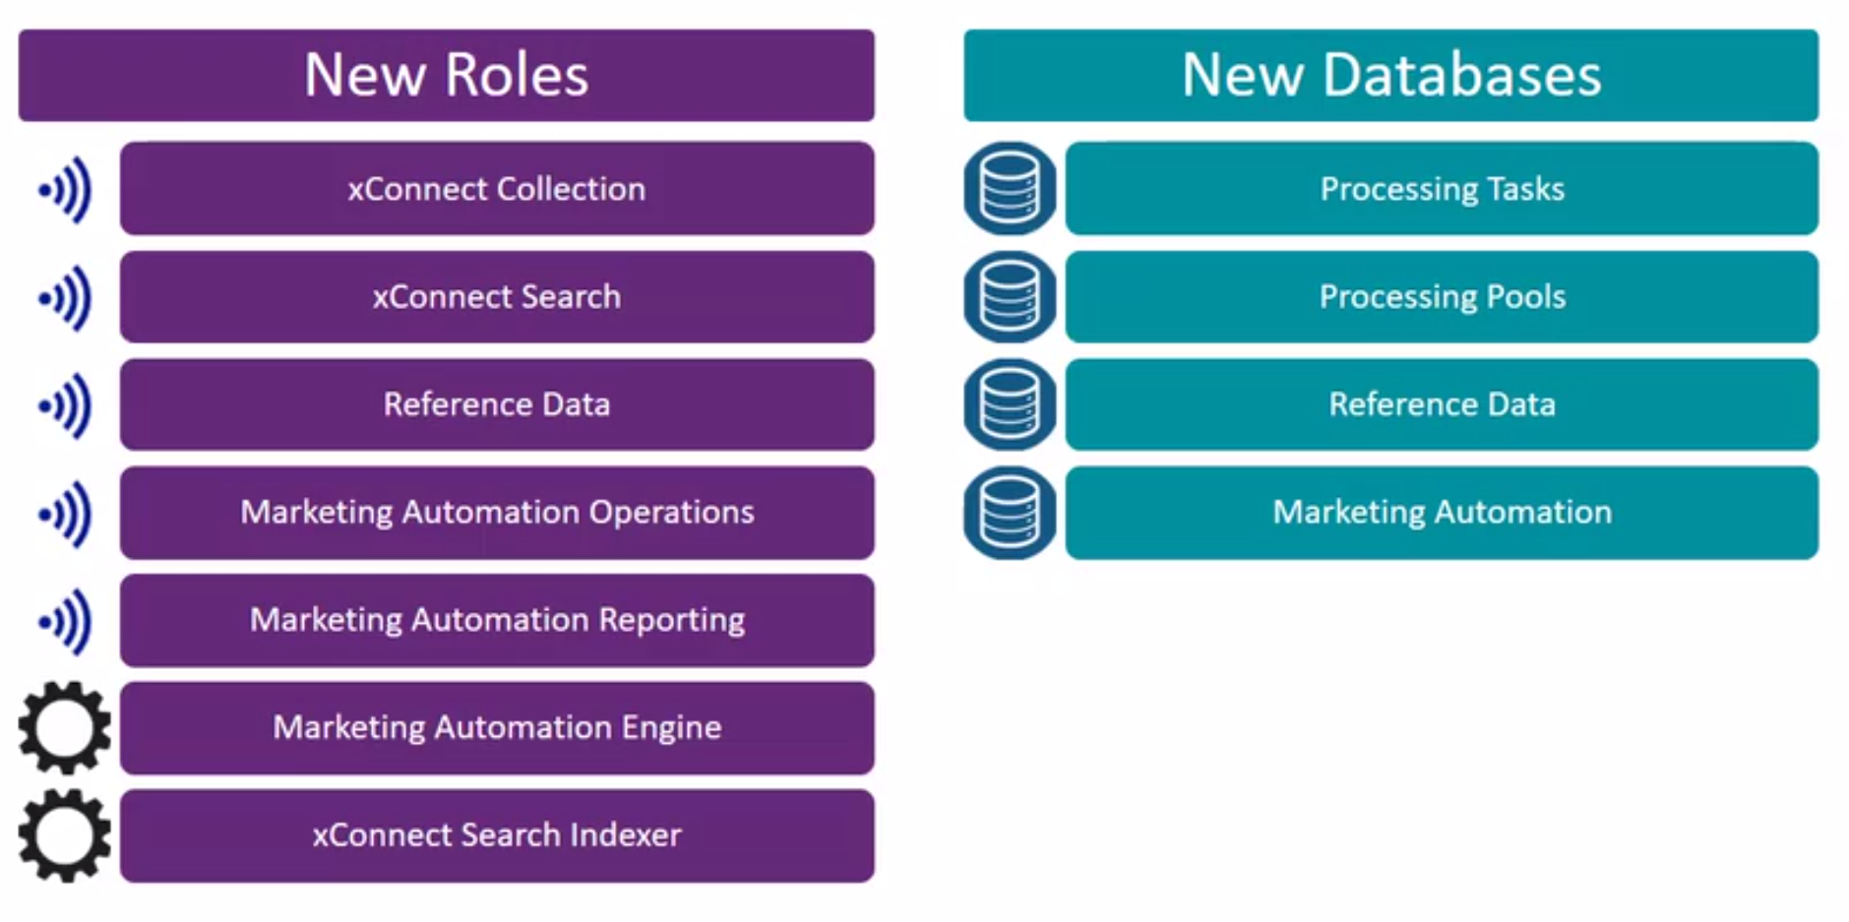
SUGNL – Sitecore xConnect
New roles & services
https://sitecore.gallery.video/detail/videos/xconnect/video/5596004966001/xconnect---scaling
Daniil @danlrby Alexei @lebeg

Slide 7
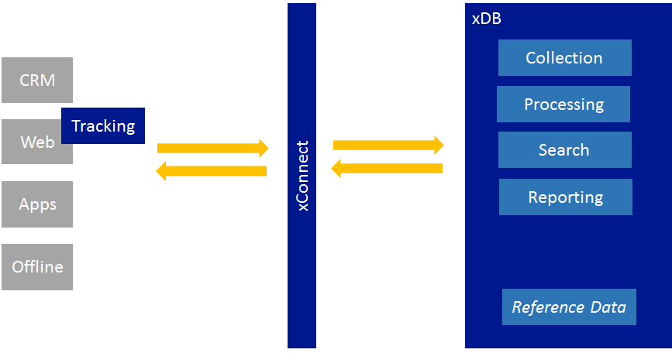
SUGNL – Sitecore xConnect
xConnect
Service Layer
Implements oData protocol
Provider based
Use xConnect to read/write/search
Supports sync/async
Supports batching
Secure
Customizable
Not xDB
Daniil @danlrby Alexei @lebeg
Notes:
xConnect implements an optimistic concurrency model. This means that contacts and facets are not locked when they are read.
xConnect will throw an exception in case of conflict and return the facet that is currently in storage.

Slide 8
SUGNL – Sitecore xConnect
Core
components
xConnect Collection service
xConnect Search service
Automation Operations & Reporting
Marketing Operations
Daniil @danlrby Alexei @lebeg

Slide 9
SUGNL – Sitecore xConnect
Experience/Collection Data
Daniil @danlrby Alexei @lebeg

Slide 10
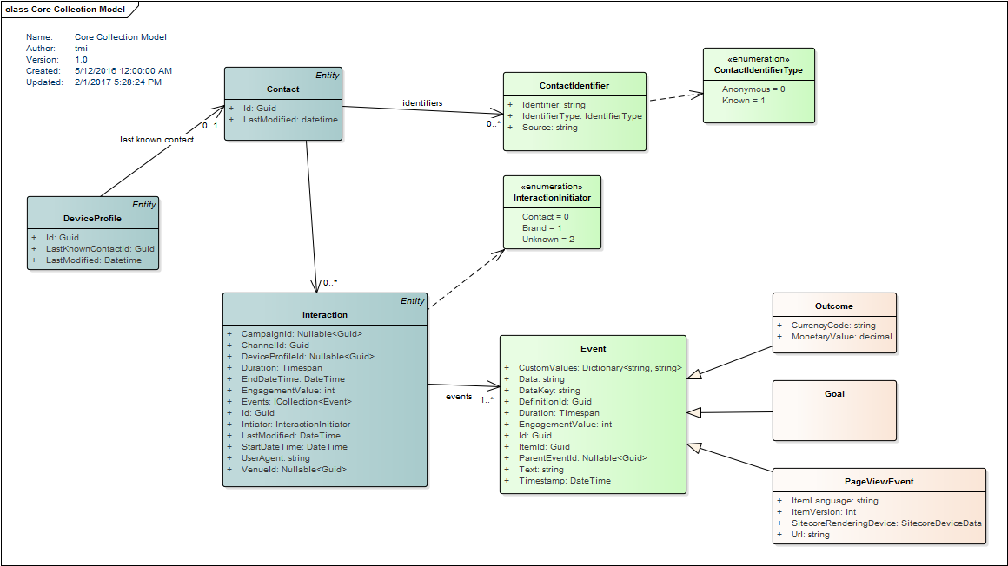
SUGNL – Sitecore xConnect
xConnect Facets
Daniil @danlrby Alexei @lebeg

Slide 11
SUGNL – Sitecore xConnect
xConnect default Facets
Daniil @danlrby Alexei @lebeg

Slide 12
SUGNL – Sitecore xConnect
Sitecore xConnect & Marketing Automation Demo
Daniil @danlrby Alexei @lebeg

Slide 13
SUGNL – Sitecore xConnect
The tracker is used on Sitecore Content Delivery servers to track a contact during a session. The tracker has its own data model which is converted into a format for xConnect by the XConnectDataAdapter
Daniil @danlrby Alexei @lebeg
Notes:
The web tracker is responsible for recording a contact’s activity during a web session, such as page views and goals triggered. On session end, this data is converted into an xConnect interaction and submitted to xConnect using the xConnect Client API. xConnect and the tracker are separate components with separate data models.
The reason for this architecture is to limit the number of breaking changes between 8.2 and 9.0. With the tracker, you are able to:
Load contact facets from xConnect in read-only mode - changes to facets must be sent directly to xConnect
Trigger events - these are converted into xConnect events before session end
Save interaction facets - these are converted into an xConnect format on session end
Add additional identifiers to a contact - 9.0 adds support for multiple identifiers
Contact locking does not exist in 9.0. Contact data is read-only in the context of the tracker - to update facets, you must use the xConnect Client API directly. This means that other sources can update a contact with an ongoing session.
ContactManager.RemoveFromSession(contactid);

Slide 14
SUGNL – Sitecore xConnect
Daniil @danlrby Alexei @lebeg
Notes:
By default, anonymous contacts are not indexed and therefore not searchable
If a facet or property is marked PIISensitive, it is not indexed. This means you cannot search using this facet or property. Customers decide if they need to enforce PII compliance - xConnect only gives them the mechanism to do so. Note that you can still return PII sensitive data (such as a contact’s first name) even though you cannot search for a contact by their first name.
Experience data is indexed, but not stored - only IDs and sync tokens are stored. When you use expand options to return facets as part of a query, that data is coming from the collection database - not from the index.
xConnect implements an optimistic concurrency model. This means that contacts and facets are not locked when they are read

Slide 15
SUGNL – Sitecore xConnect
Daniil @danlrby Alexei @lebeg
Notes:
You can use expand options to customize what data is returend, just as you did with .Get(). In the following example, ContactExpandOptions and InteractionExpandOptions are being used to return additional data with each contact and interaction:

Slide 16
SUGNL – Sitecore xConnect
Daniil @danlrby Alexei @lebeg
Notes:
As a developer, you can extend xConnect in the following ways:
You can extend the collection model by:
Adding contact and interaction facets
Adding custom events
Add service plugins such as calculated facet merge handlers
The collection model defines the CLR types, facets, and events that make up the structure of experience data. Sitecore ships with a default collection model that defines facets such as PersonalInformation and event types such as Goal and Outcome. You can define any number of additional models with your own facets and events.
All models are defined entirely in code.
In the context of a console application, the xConnect Client API can be initialized with the custom model:
Alternatively, the custom model can be added to configuration in Sitecore. When the application starts, a runtime model is assembled from all models listed in configuration and is available when you request the xConnect client
Tools exist to serialize the model into JSON. The JSON and C# versions of a model must match, otherwise the xConnect Client API will fail to initialize. xConnect only needs the JSON representation of a model - there is no need to deploy DLLs.
Naming conventions Apply

Slide 17
SUGNL – Sitecore xConnect
Daniil @danlrby Alexei @lebeg

Slide 18
SUGNL – Sitecore xConnect
Daniil @danlrby Alexei @lebeg

Slide 19
SUGNL – Sitecore xConnect
xConnect Facets used across the demo
AutomationPlanEnrollmentCache
Avatar
Classification
ContactBehaviorProfile
EmailAddressHistory
Emails
EngagementMeasures
ExmKeyBehaviorCache
FaceApiContactInfo
InteractionsCache
KeyBehaviorCache
ListSubscriptions
Personal
PhoneNumbers
Daniil @danlrby Alexei @lebeg

Slide 20
SUGNL – Sitecore xConnect
xConnect Api Features
Calculated facets
Search
No Sitecore.ContentSearch
xConnect Service plugins
XdbContactEventWatcher
Example: Batch executing, Operation completed
Right to be forgotten
Daniil @danlrby Alexei @lebeg

Slide 21
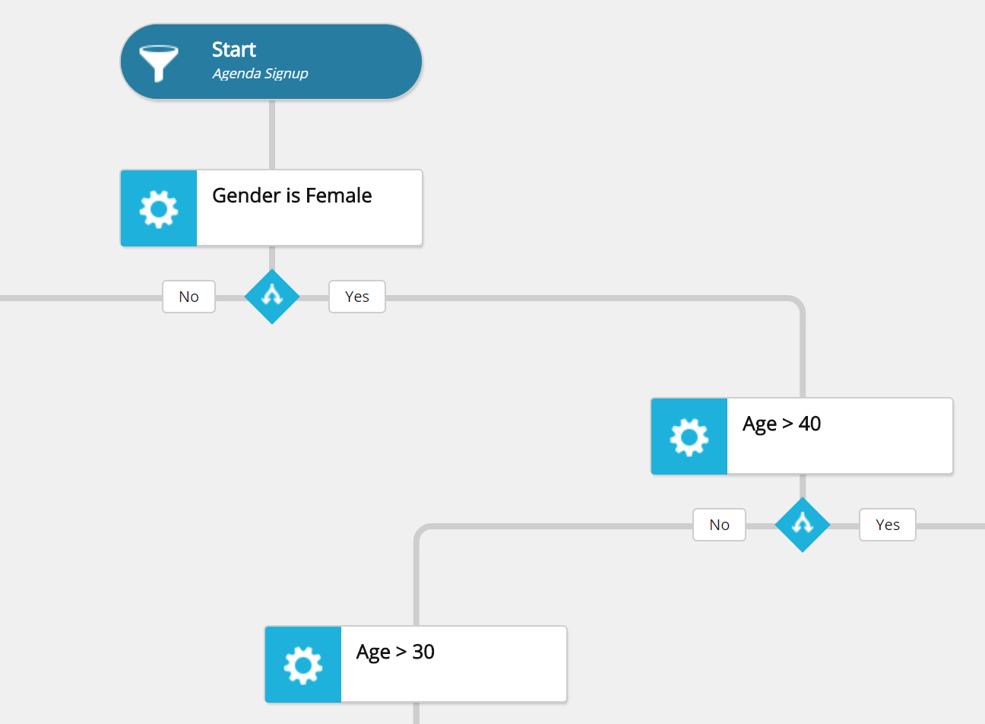
SUGNL – Sitecore Marketing Automation
Marketing Automation
New way to create automated campaigns
Easy & User friendly
Customizable
Is a stand-alone Windows Service/Console App/Azure Web Job
Daniil @danlrby Alexei @lebeg

Slide 22
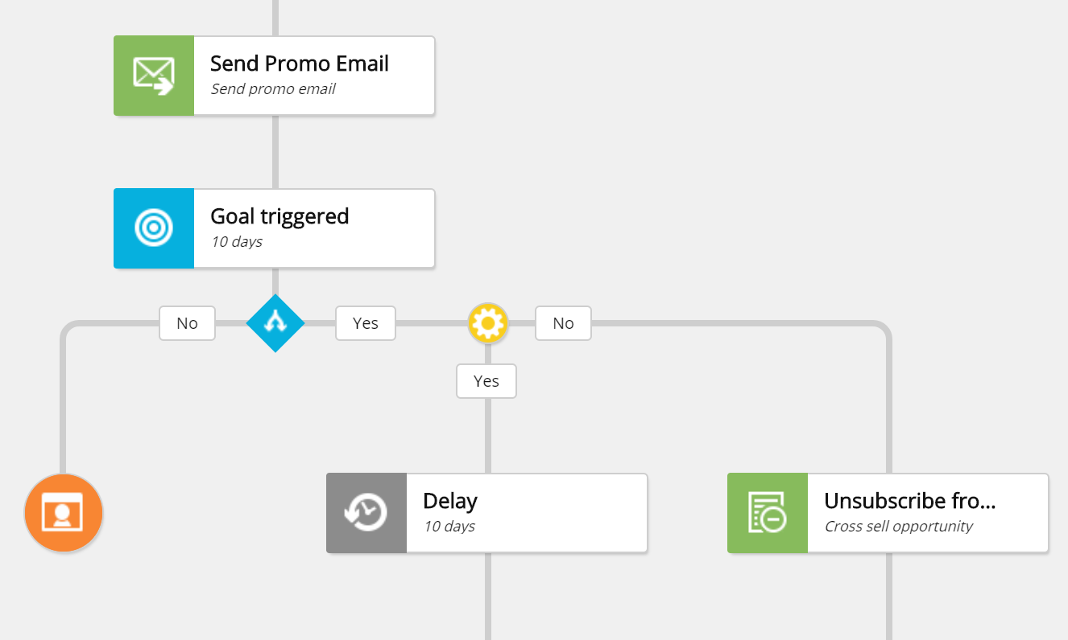
SUGNL – Sitecore Marketing Automation
Built in Action Types Classification
Campaign Entry
Marketing Action
Listeners
Decision Points
Other
Daniil @danlrby Alexei @lebeg

Slide 23
SUGNL – Sitecore Marketing Automation
Automation enrollment
Automation processing pool - A new entity (contact or interaction) is created in xConnect
Timeout worker - regularly evaluates all ‘Pause’ activities
Operations API - directly, bypassing the processing pool
Enroll contact in a plan(s)
Register live event(s)
Delete contact from plan(s)
Daniil @danlrby Alexei @lebeg
Notes:
Plan pulse regulator
The default plan pulse regulator is the CyclicProtectionPlanPulseRegulator, which ensures that the same activity of a plan is not repeated too often in a single pulse. The default maximum number of single activity visits is 10. This will prevent an enrollment getting stuck in a fast loop in a poorly designed plan without pauses, which would starve the engine of available workers to handle work, as they’d be tied up processing an infinite loop.

Slide 24

SUGNL – Sitecore Marketing Automation
Custom Action
Create Activity Type backend logic and definition item
Create Activity Type Sitecore UI and Editor (Angular, Typescript)
Deploy Activity Type to Sitecore UI and MA engine
Custom Condition
Implement ICondition interface
Deploy condition definition to MA engine
Check Brimit Blog for sample activity implementation
Daniil @danlrby Alexei @lebeg
Notes:
The segmentation engine is responsible for building a query from an ISegmentDefinition or an IContactSearchQueryFactory and returning a list of contacts or a count of contacts that match those criteria

Slide 25
SUGNL
Thank you!
Daniil @danlrby Alexei @lebeg

